Slide 2


Slide 3
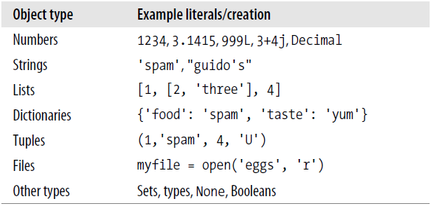

Slide 4

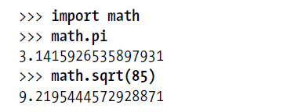
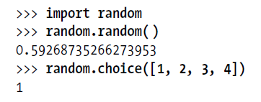
Numbers

Slide 5



String

Slide 6

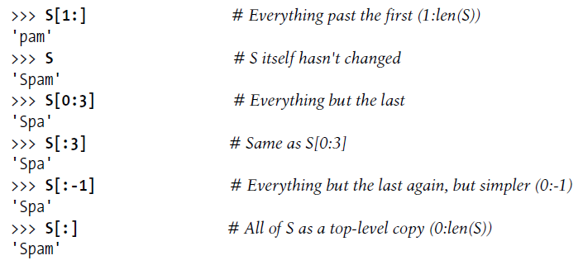

Slide 7
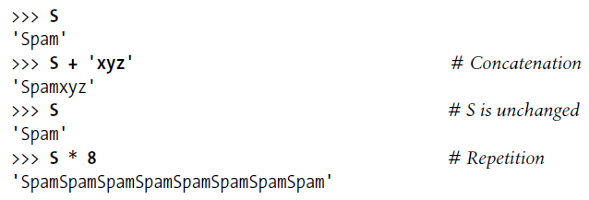


Slide 8


Slide 9
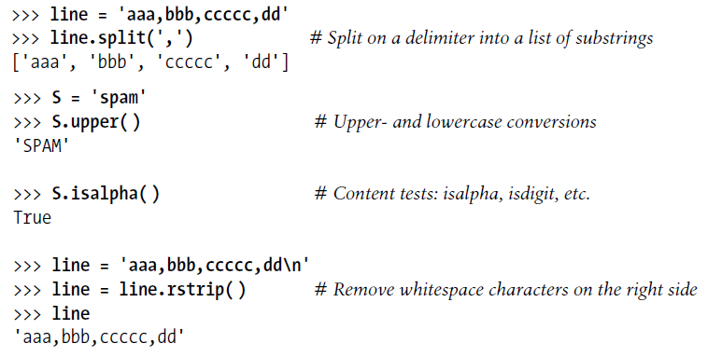

Slide 10
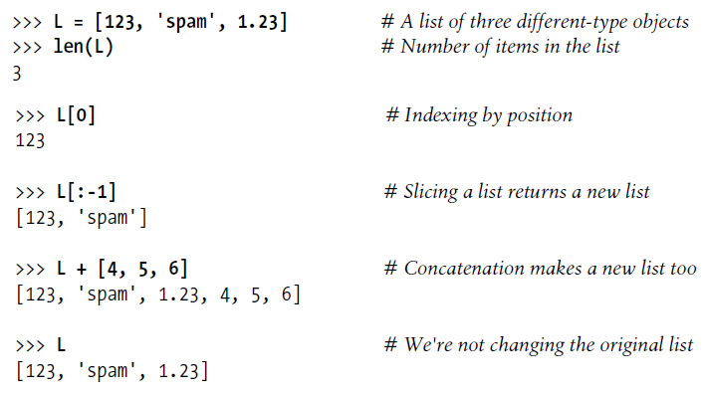
Lists

Slide 11
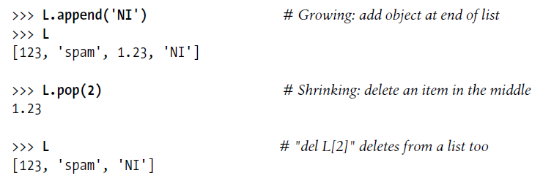

Slide 12
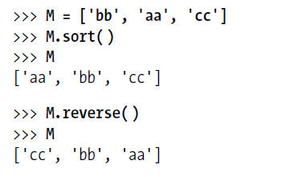

Slide 13
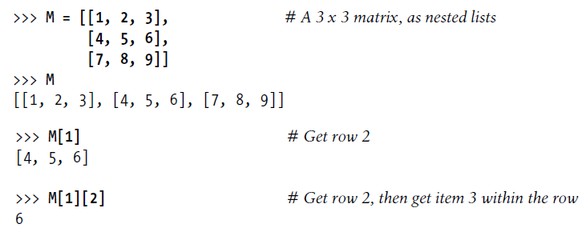

Slide 14


List comprehensions

Slide 15


Slide 16
Dictionaries
D.get(‘food’)

Slide 19
Tuples

Slide 20
Sets

Slide 21
if Statements

Slide 22
for Statements
See enumerate()

Slide 26
match Statements

Slide 27
function

